Slide 1

Logic
Design
LECTURE 2: Logic Gates &
Boolean Algebra
Lecturer: Kanar R. Tariq
University of Human Development
IT Department
@2016

Slide 2
Digital Logic Gates
The analysis and design of logic circuits are guided by Boolean algebra. In this section, we will relate Boolean algebraic concepts to logic circuits in an informal manner and then introduce Boolean algebra more formally in subsequent sections.
There are three basic logical operations: AND, OR, and NOT.

Slide 3
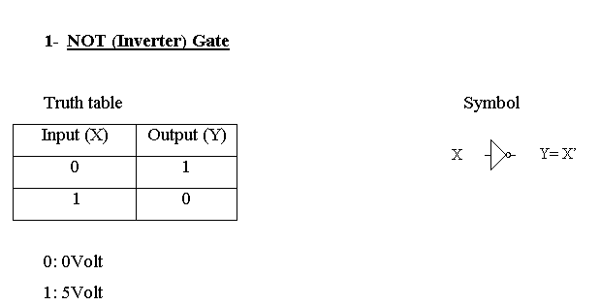
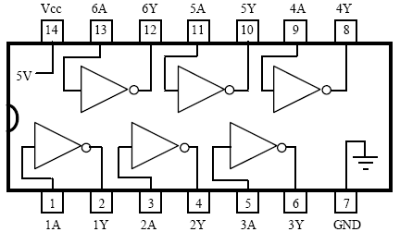

Slide 4
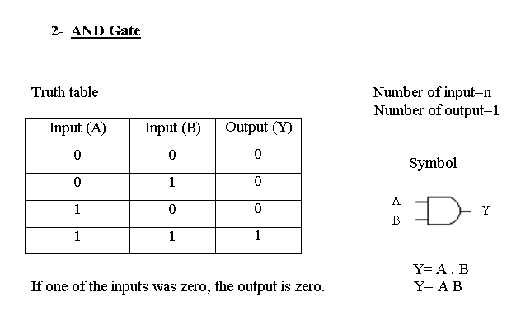
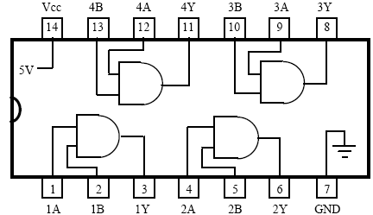

Slide 5
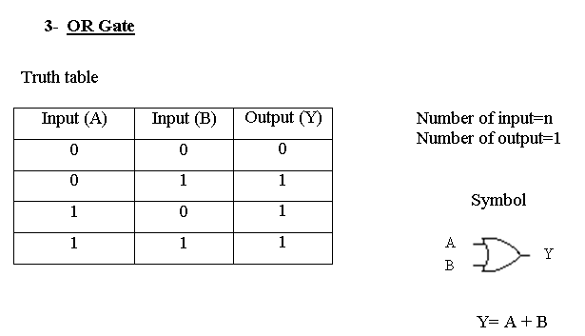
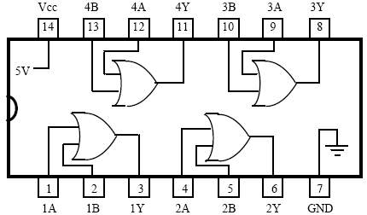

Slide 6
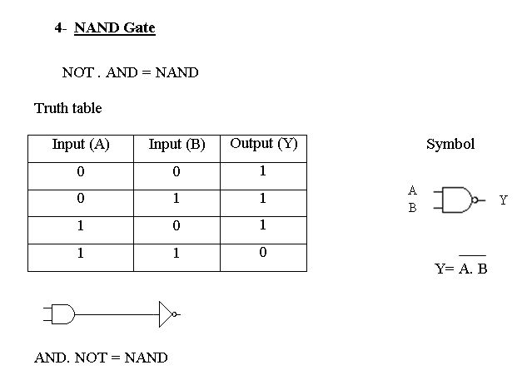
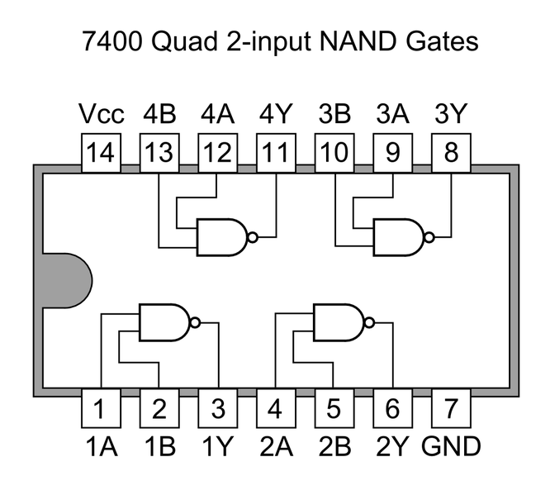

Slide 7
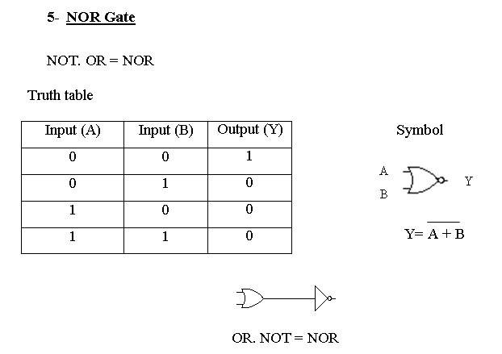
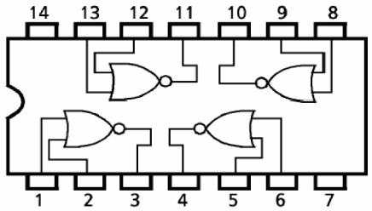

Slide 8
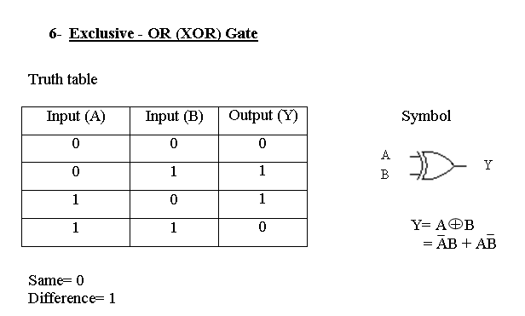
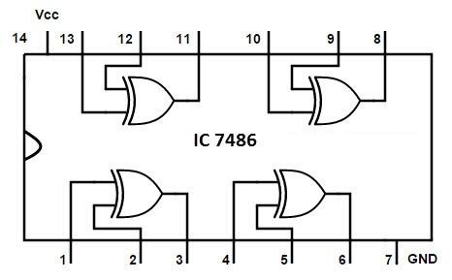

Slide 9
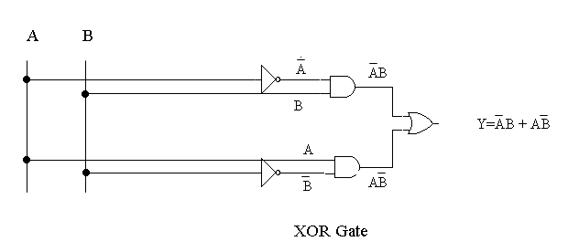

Slide 10
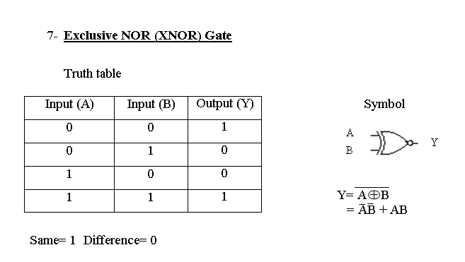

Slide 11
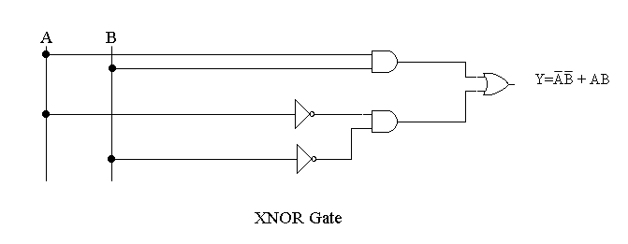

Slide 12
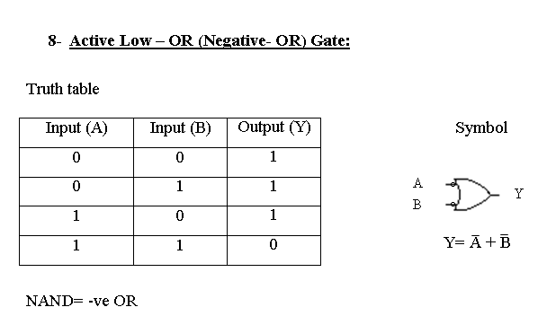
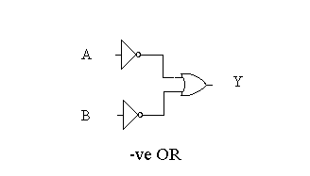

Slide 13
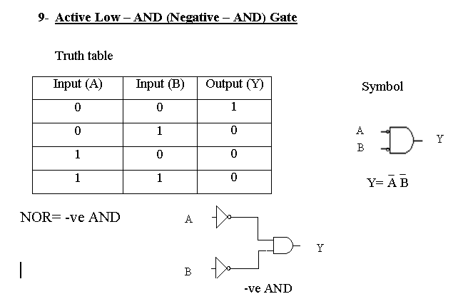

Slide 14
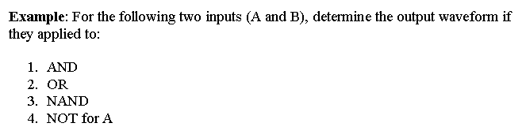

Slide 15
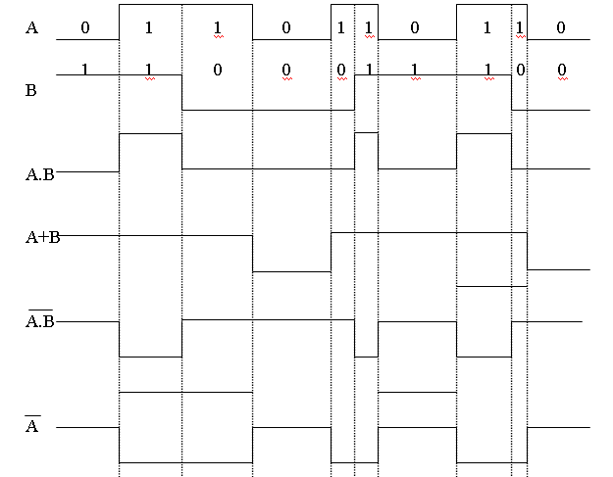

Slide 16
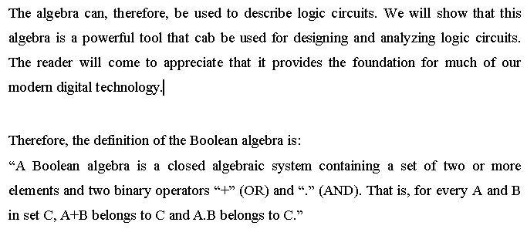
Boolean Algebra

Slide 17
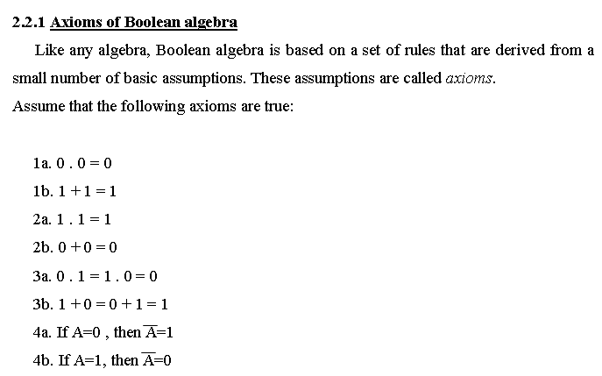

Slide 18
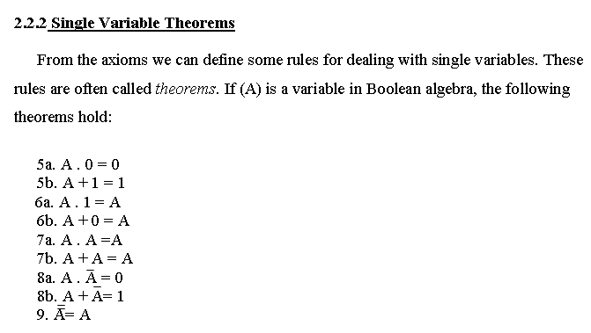

Slide 19
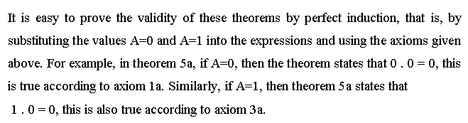

Slide 20
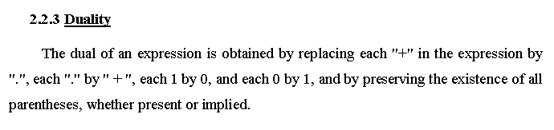

Slide 21
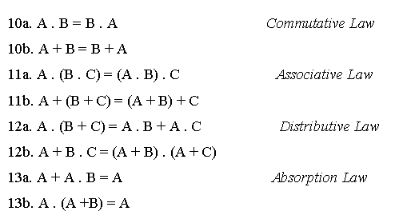
Two And Three Variable Properties
For each identity, its dual version is also given. These identities are often referred to as properties. They are known by names below. If A, B and C are the variables in Boolean algebra, then the following properties hold:

Slide 22
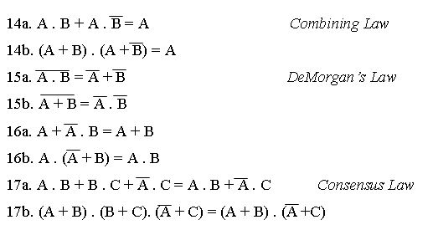

Slide 23
Boolean Functions
A Boolean function is an expression formed with binary variables, the two binary operators OR and AND, and unitary operator NOT, parentheses, and an equal sign. For the given value of the variables the function can be either 1 or 0.

Slide 24
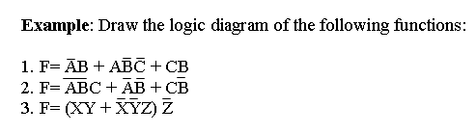

Slide 25
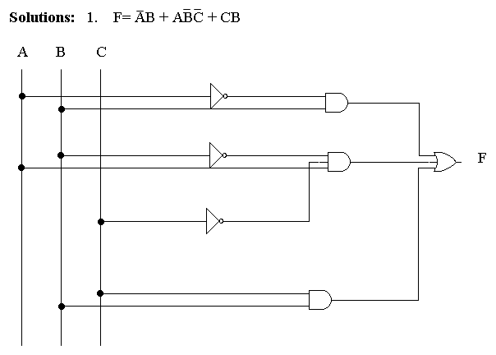

Slide 26
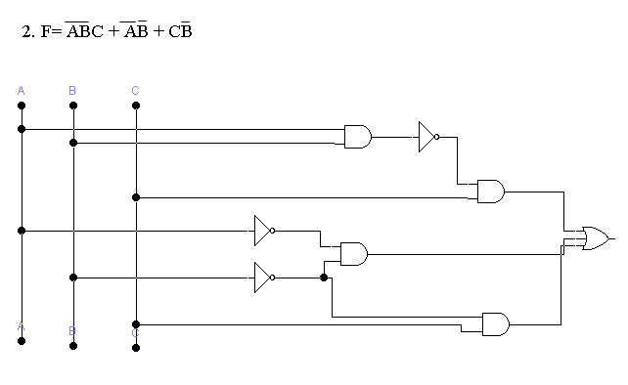

Slide 27
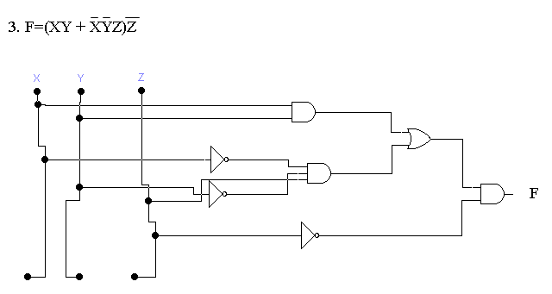

Slide 28
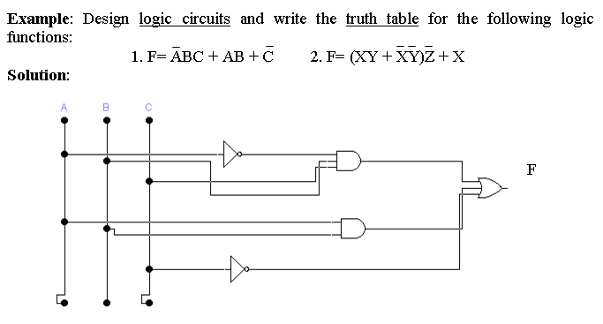

Slide 29
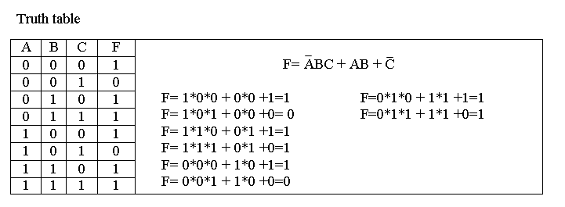

Slide 30
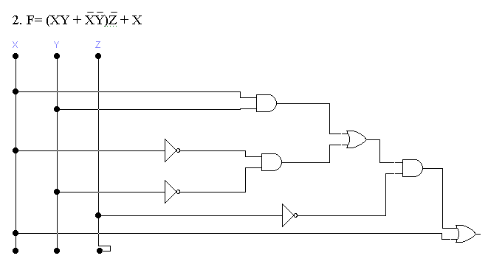

Slide 31
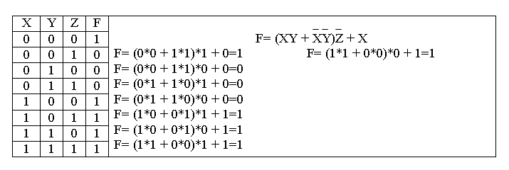

Slide 32
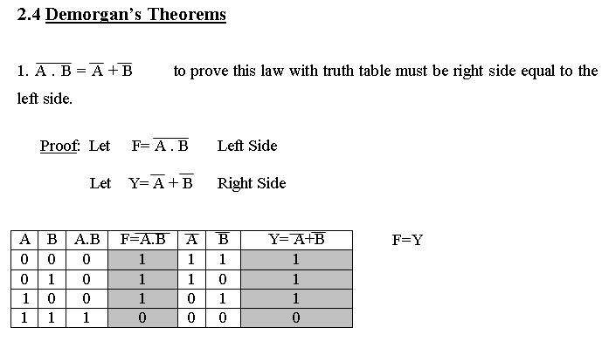

Slide 33
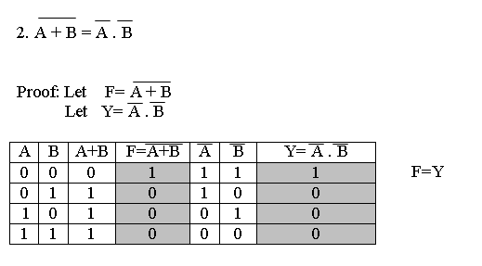

Slide 34
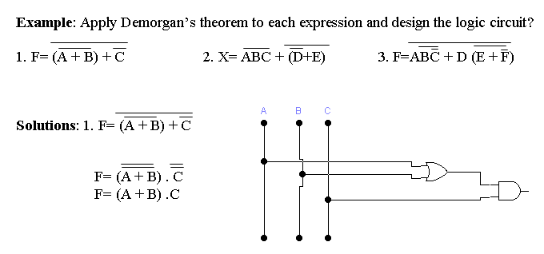

Slide 35
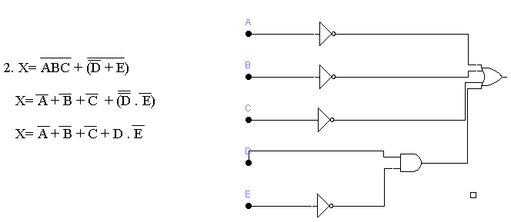

Slide 36
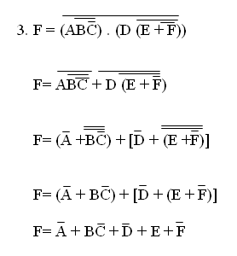
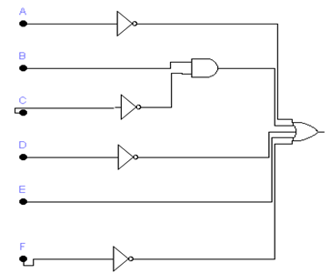

Slide 37
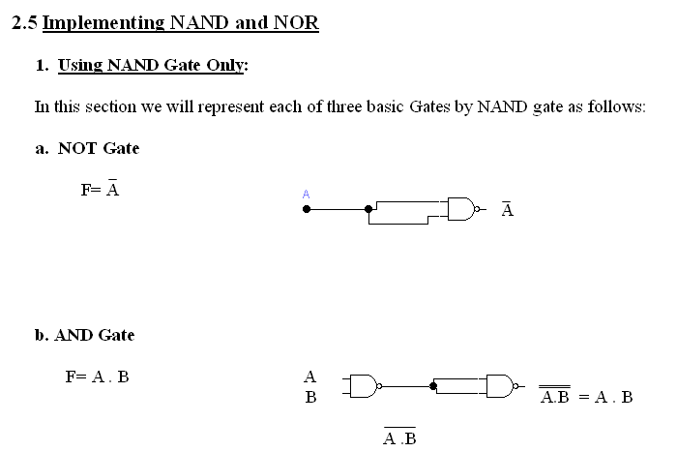
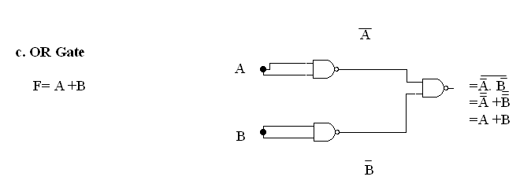

Slide 38
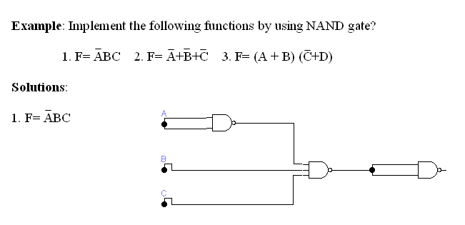

Slide 39
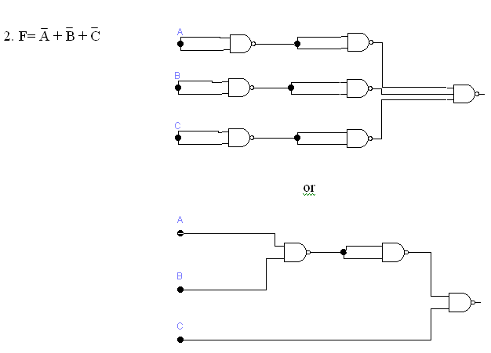

Slide 40
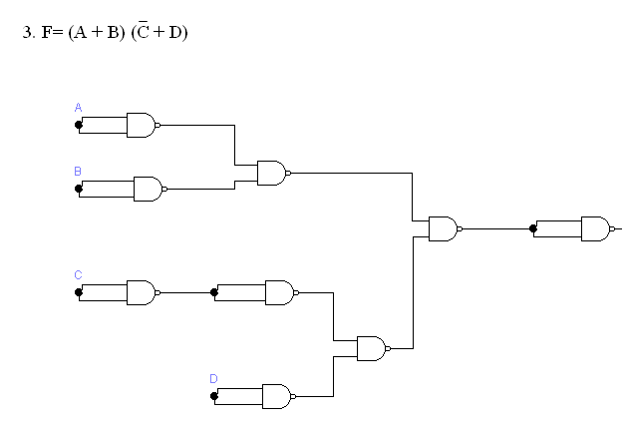

Slide 41
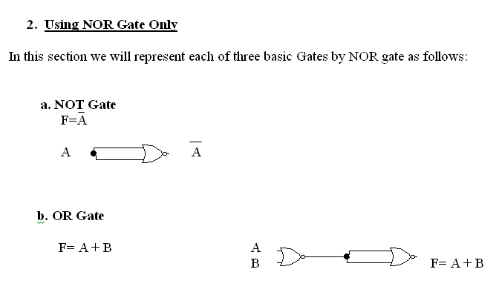
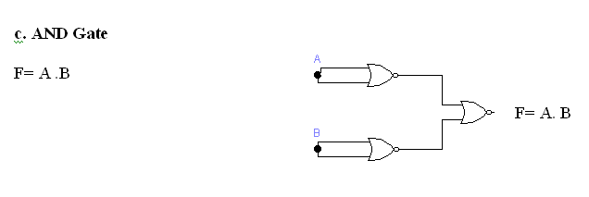

Slide 42
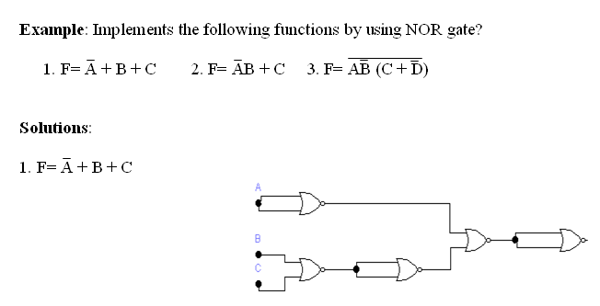
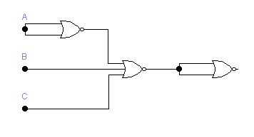

Slide 43


Slide 44


Slide 45
Integrated Circuits (IC)
Digital circuits are constructed with integrated circuits.
An integrated circuit (abbreviated IC) is a small silicon semiconductor, called a chip.
The various gates are interconnected inside the chip to form the required circuit.
Number of pins may range from 6 to 64.
Example: 4 AND gate are inside in the 14Pin IC Package.
Example: SIM Card Chip (6 Pin)
Example: Each IC have a family number (7400,….)

Slide 46


Slide 47


Slide 48
Levels of Integration
Digital ICs are often categorized according to their circuit complexity as measured by the number of logic gates in a single package.
Small-scale integration (SSI): contain several independent gates in a single package. No. of gates <10
Medium-sale integration (MSI): have a complexity of approximately 10 to 100 gates in a single package.
Large-scale integration (LSI): contain between 100 and a few thousand gates in a single package.
Very large-scale integration (VLSI): contain thousands of gates within a single package.

Slide 49
Digital Logic Families
Digital integrated circuits are classified not only by their complexity or logical operation, but also by the specific circuit technology to which they belong.
Each logic family has its own basic electronic circuit upon which more complex digital circuits and components are developed.
Models:
TTL Transistor-Transistor Logic
ECL Emitter-Coupled Logic
MOS Metal-Oxide Semiconductor
CMOS Complementary Metal-Oxide Semiconductor

Slide 50
TTL is a widespread logic family that has been in operation for some time and is considered as standard.
ECL has an advantage in systems requiring high-speed operation.
MOS is suitable for circuits that need high component density.
CMOS is preferable in systems requiring low power consumption.

Slide 51
The characteristics of digital logic families are usually compared by analyzing the circuit of the basic gate in each family
Fan-out specifies the number of standard loads that the output of a typical gate can drive without impairing its normal operation. A standard load is usually defined as the amount of current needed by an input of another similar gate of the same family.
Power dissipation is the power consumed by the gate that must be available from the power supply.

Slide 52
Propagation delay is the average transition delay time for the signal to propagate from input to output. The operating speed is inversely proportional to the propagation delay.
Noise margin is the minimum external noise voltage that causes an undesirable change in the circuit output.

Slide 53


Slide 54


Slide 55


Slide 56


Quiz No. 2
c

Slide 57
The END

